Slide 1


Forms and Validators
Handling Forms, Validation with Vuelidate
SoftUni Team
Technical Trainers
Software University
http://softuni.bg

Slide 2
Table of Contents
Handling Forms
Two-way Data Binding (v-model)
Text Binding, Checkboxes, Radio buttons, Submitting etc.
Input Modifiers
Form Input Validation
Vuelidate

Slide 3
Have a Question?
sli.do #vue-js

Slide 4

Handling Forms
V-model, Input Types, Submitting

Slide 5
Two-way Data Binding
Achieved using the v-model directive
Essentially syntax sugar for updating data
Based on user input events
Supports input modifiers
Automatically picks the correct way to update an element based on the input type

Slide 6
Text Binding Example
Bind to a data property and update it directly
<input v-model="message" placeholder="edit me">
<p>Message is: {{ message }}</p>
data() {
return {
message: ''
}
}

Slide 7

Forms Overview
Forms are the mainstay of business applications
We use Forms to:
Register/Log in
Submit a help request
Place an order
Book a flight and more
Guide the user efficiently and effectively when creating forms

Slide 8
Problem: Registration Form
Create a registration form with the following input fields:
Email, Password, Age, Description, Skill Set (checkbox), Gender (radio), Country (select)
Use v-model on all input fields
Handle the submit event and prevent the default behavior
After submitting -> show the data you have entered
Bonus: Create a reusable input field component for the email

Slide 9
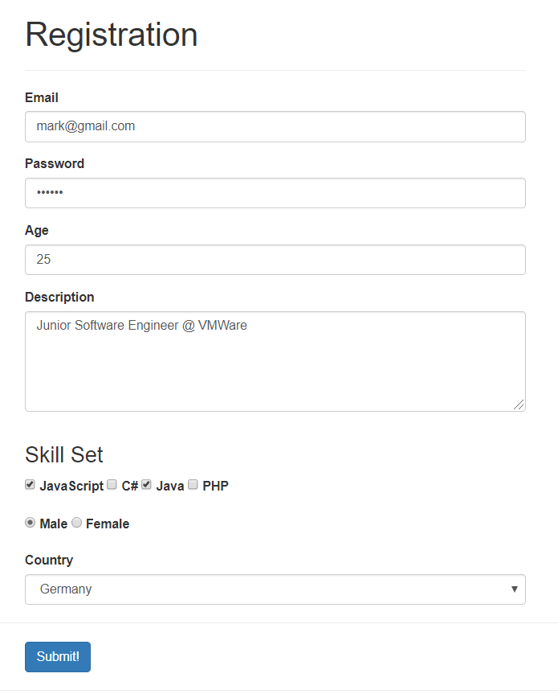
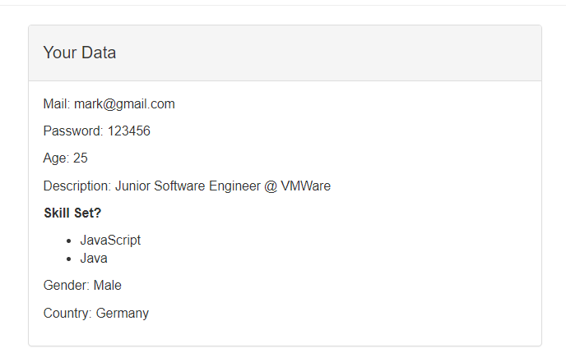
Problem: Registration Form

Slide 10


Multiline Text
Interpolation on textareas won't work
Use v-model instead
<textarea id="description" rows="5">
{{ description }}
</textarea>
<textarea id="description" rows="5" v-model="description">
</textarea>

Slide 11
Checkbox
Multiple checkboxes are bound to an array
<label for="js">
<input type="checkbox" id="js" value="JavaScript"
v-model="skillSet" /> JavaScript
</label> // TODO: Add 3 more languages (bind to same model)
skillSet: [] // Data

Slide 12
Radio Buttons
Radio Buttons are bound to a single option (model)
<label for="male">
<input type="radio" id="male" value="Male"
v-model="gender" /> Male
</label>
<label for="female">
<input type="radio" id="female" value="Female"
v-model="gender" /> Female
</label>

Slide 13
Select List
Loop through an array of options (select only one)
countries: [ 'Bulgaria', 'Germany', 'England' ] // Data
<select id="country" class="form-control"
v-model="selectedCountry">
<option v-for="country in countries" :key="country">
{{ country }}
</option>
</select>

Slide 14
Input Modifiers
By default, v-model syncs the input with the data after each input event
You can add the lazy modifier to instead sync after change events
// synced after "change" instead of "input"
<input type="password" v-model.lazy="userData.password">

Slide 15
Input Modifiers
Add number modifier to automatically typecast as a number
Often useful, because even with type="number", the value of HTML input elements always returns a string
Trim whitespaces from user input
<input v-model.number="age" type="number">
<input v-model.trim="userData.password" type="password">

Slide 16
Submitting a Form
Handle submit event and prevent default behavior (refresh)
<form @submit.prevent="registerHandler">
</form>
registerHandler() {
// TODO: Check if data is bound correctly
this.isSubmitted = true; // TODO: Show User Data
// OPTIONAL: Send Data to a Server
}

Slide 17
Reusable Input Component
Sometimes reusing form controls is required
Create a separate component with "custom" two-way data binding
<template> // TODO: Add form group + label
<input type="text" id="email" class="form-control"
:value="email"
@input="inputHandler" />
</template>

Slide 18
Reusable Input Component
Pass down the value as props (String)
Emit a custom event on input (on change for lazy)
props: { email: String },
methods: {
inputHandler(e) {
this.$emit('onInput', e.target.value);
}
}

Slide 19
Reusable Input Component
Register the Component
Pass down the value and listen to changes
<app-email-input
:email="userData.email"
@onInput="userData.email = $event">
</app-email-input>

Slide 20

Input Validation
Vuelidate

Slide 21
Client-Side Validation
Fast form of validation
Form validation is natively supported by the browser
Error messages are shown upon filling the form
Gives better feedback to the average user
Saves time and bandwidth
Not secure, can be easily disabled by the user
Shouldn't be used independently

Slide 22
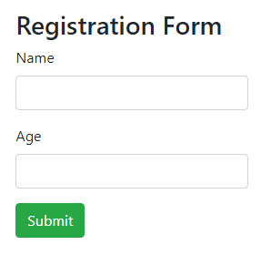
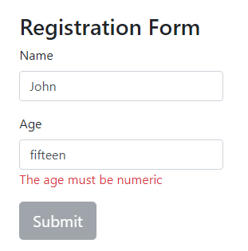
Base Example
Error message is displayed immediately
You can disable the submit button as well

Slide 23
Vuelidate
Simple, lightweight model-based validation plugin
Flexible, decoupled from templates
Dependency free, minimalistic library
Many built-in validators
Easy to use with custom validators
High test coverage
Docs: https://vuelidate.netlify.com/#getting-started

Slide 24
Vuelidate Installation
Available on npm
Import the library and use as a Vue plugin to enable the functionality globally
npm install vuelidate --save
import Vue from 'vue'
import Vuelidate from 'vuelidate'
Vue.use(Vuelidate)

Slide 25
Problem: Add Form Validation
Add validation and show UI Messages for the registration form
Email - required and email validator
Password – required, minLength(4), maxLength(16), alphanumerical characters
Age – required, minValue(18)
Description – maxValue(100)
Bonus: Add a confirm password field that should match the password

Slide 26
Configure Validations
Each component now has "validations" property
validations: {
email: { },
password: { },
age: { },
description: { }
}
Property name must match data name

Slide 27
Build-in Validators Example
Import the wanted validator from the package
Add it as a property
import {
required, email
} from 'vuelidate/lib/validators';
validations: {
email: { required, email }
}

Slide 28
Built-in Validators List
numeric - Accepts only numerics
aplhaNum - Accepts only alphanumerics
integer - Accepts positive and negative integers
decimal - Accepts positive and negative decimal numbers.
sameAs - Checks for equality with a given property
maxLength - Requires the input to have a max specified length
minLength - Requires the input to have a min specified length

Slide 29
Instance Methods
Control validation model -> accessible on every level vie "$v"
$touch - Sets the $dirty flag of the model to true
$reset - Sets the $dirty flag of the model to false
<input type="text"
id="email"
v-model="email"
@input="$v.email.$touch()" />
Could also be @blur

Slide 30
Show UI Messages
Use the $error property
<template v-if="$v.email.$error">
<div class="alert alert-danger">
Email is invalid!
</div>
</template>
Shown only when the field is invalid AND touched

Slide 31
Show Different Messages
The form control has access to all validators
<template v-if="$v.password.$error">
<div class="alert alert-danger"
v-if="!$v.password.minLength || !$v.password.maxLength">
Password is must be between 4 and 16 characters (inclusive)
</div>
</template>
Returns true if invalid

Slide 32
Blocking Submit Button
Disable the submit button if ANY control is invalid
<div class="row">
<div class="col-xs-12 col-sm-8 col-sm-offset-2 col-md-6 col-md-offset-3">
<button class="btn btn-primary"
:disabled="$v.$invalid">Submit!
</button>
</div>
</div>

Slide 33
Vuelidate More Examples
Validate Passwords with sameAs
Collection validation using $each https://vuelidate.netlify.com/#sub-collections-validation
Custom validators https://vuelidate.netlify.com/#custom-validators
Asynchronous validation and many more https://vuelidate.netlify.com/#sub-asynchronous-validation

Slide 34

Summary
…
…
…
Two-way Data Binding with v-model
Text, Checkbox, Radio and Select List Bindings, Input Modifiers
Extracting Custom Form Controls
Front-end Validation with Vuelidate
Validators, UI Messages etc.

Slide 35
https://softuni.bg/trainings/2430/vuejs-fundamentals-july-2019

Slide 36












SoftUni Diamond Partners

Slide 37




SoftUni Organizational Partners

Slide 38





Trainings @ Software University (SoftUni)
Software University – High-Quality Education, Profession and Job for Software Developers
softuni.bg
Software University Foundation
http://softuni.foundation/
Software University @ Facebook
facebook.com/SoftwareUniversity
Software University Forums
forum.softuni.bg

